Slide 1

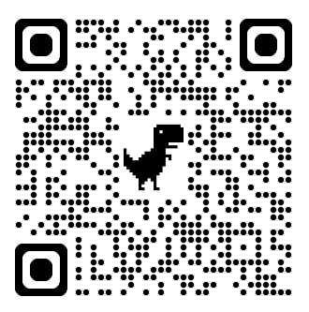




Register here
Breathe and Think: Neuro and Respiratory insights for Midwives
30th September 2025 6.30pm – 8.00pm
MOMS is delighted to announce a new series of webinars, specifically for midwifery colleagues.
This is the first webinar and will concentrate on neurology and respiratory issues.
The speakers are:
Dr Katie Cranfield, Intensivist and Obstetric Physician, Newcastle-Upon-Tyne NHSFT
Dr Pooja Dassan, Consultant Neurologist, Imperial College Healthcare NHS Trust
Dr Aoife Quinn, Neuro and Trauma Intensivist, Cambridge University Hospitals Trust
Available to watch for 4 weeks after the live event, via the webinar page on www.obstetricmedic.org.uk.
All welcome! Please share with friends and colleagues.
Please follow us on social media for more updates!

