Slide 1

Diabetes in Children: Importance of Early Diagnosis
This presentation has been developed by the Children and Young People’s National Diabetes Network. It is aimed at all health professionals who might meet children presenting with diabetes.

Slide 2
Learning Objectives
What is type 1 diabetes mellitus
Why is early diagnosis of type 1 diabetes important
How do children present with diabetes
How to recognise a child in DKA
What actions to take when seeing a child with possible diabetes

Slide 3
What is Type 1 Diabetes (T1D)
Type 1 Diabetes Mellitus is:
An autoimmune condition in which immune destruction of the insulin producing cells in the pancreas leads to insulin deficiency
Without insulin:
There is breakdown of fat → weight loss
Glucose levels rise → increased urination and increased thirst
Glucose cannot enter cells to provide energy → tiredness
Accumulation of ketones → diabetic ketoacidosis

Slide 4
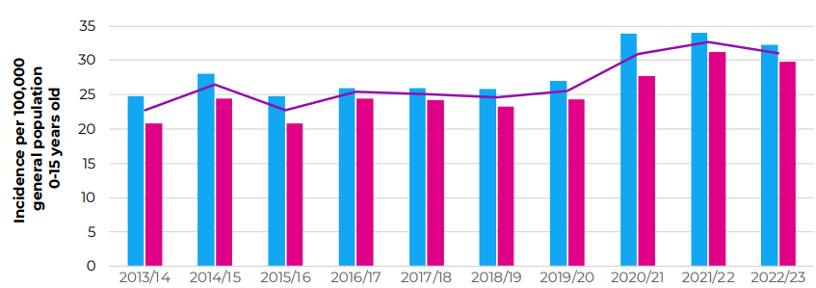
How common is Type 1 Diabetes
T1D affects around 34,000 children and young people in England and Wales
There were 3610 new cases children in E&W in 2022/23
Incidence has been rising in recent years
Source: NPDA Annual Report 2022/23

Slide 5
How Does Type 1 Diabetes Develop
Initial trigger is not clearly understood
Genetic and environmental factors are important:
Children with affected relatives are more likely to develop T1D
There are then 3 stages:
Stage 1 – diabetes auto-antibodies are detectable in the blood
Stage 2 – glucose levels start to rise but there are no clinical symptoms
Stage 3 – clinical symptoms develop
Most children are diagnosed in stage 3 – when clinical symptoms appear
Notes:
Some children may be detected in stage 2 with incidental finding of asymptomatic hyperglycaemia. Stage 1 is not usually diagnosed outside of research studies.

Slide 6
Why is early diagnosis important
T1D progresses FAST
Most children have a period where there are clinical symptoms of diabetes but the child is still well
This period can be months, weeks or sometimes only days
If the diagnosis is not made in this period, the child becomes unwell and develops diabetic ketoacidosis (DKA)
DKA is a serious condition and can be fatal

Slide 7
What is Diabetic Ketoacidosis (DKA)
DKA is a life-threatening complication of diabetes
It comprises dehydration, high glucose levels, and high ketone levels - leading to acidosis
In DKA:
The breathing rate rises
The pulse rate rises
The child feels increasingly unwell
Vomiting may develop worsening the dehydration
Untreated there is increasing cardiovascular collapse leading to:
Shock
Renal failure
Coma

Slide 8
Question
In 2019-20 in England & Wales, 2799 children under 16 were diagnosed with T1D.
What percentage do you think were in DKA at diagnosis?
Source: National Paediatric Diabetes Audit
The answer is 38.5%
That is 1078 children who could have avoided DKA if diagnosed earlier

Slide 9
Impact of DKA
All children:
Cannulation – often difficult
IV fluids, IV insulin
Intensive monitoring
Hourly blood glucose checks
4 hourly U&Es and blood gas
Often need HDU – sometimes ITU
Can lead to:
Cerebral oedema
Permanent brain injury
Renal failure
Limb ischaemia/amputation
Death
Traumatic and frightening experience for child and parents
Can lead to:
Anxiety
Post traumatic stress symptoms

Slide 10
Long term impacts of DKA at diagnosis
Single episode of moderate/severe DKA in young children at diagnosis is associated with lower cognitive scores and altered brain growth
DKA at diagnosis associated with worsened long term glucose control independent of other demographic/socioeconomic factors

Slide 11
Death from DKA
Most children with DKA will survive with hospital treatment, but sadly some children will die from DKA.
Follow the link below to watch a short video of a parent telling their story.
https://www.bbc.co.uk/news/uk-wales-44808388

Slide 12
Question
What experiences do you have of seeing a child presenting with T1D?
What are the key symptoms to be aware of?
Notes:
Allow participants to share examples of children they have seen diagnosed with T1D

Slide 13
Getting Diagnosed
Getting diagnosed with diabetes before the onset of DKA involves the following steps:
Family recognise there is something wrong with their child
Family contact health services
GP practice triages urgency of appointment
Health care professional suspects type 1
Health care professional tests for diabetes

Slide 14
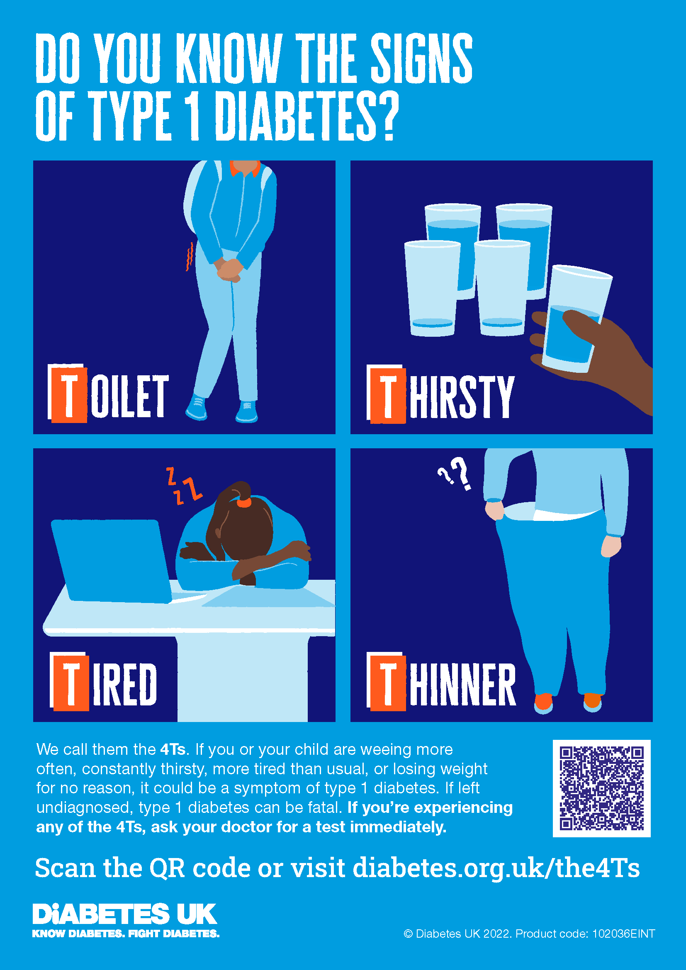
Recognising T1D
There are 4 key symptoms of T1D
These are summarised by the Diabetes UK 4Ts campaign:
Toilet
Thirsty
Tired
Thinner

Slide 15
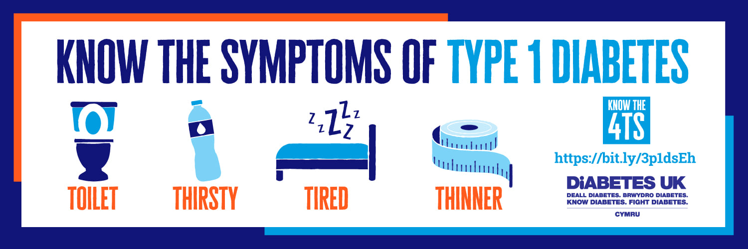
The 4Ts
Toilet
Passing urine more than normal
Needing to wee in the night
New onset bedwetting
May notice sticky toilet seat/glucose crystals
Babies - excessively heavy nappies
Thirsty
Drinking a lot more than normal
Needing to drink in the night
May help themselves from tap in the night
Babies - feeding lots
Be particularly wary of these symptoms!
Children with these symptoms are at high risk of decompensating → DKA

Slide 16
The 4Ts
Thinner
Weight loss may be the only initial presenting feature and often precedes osmotic symptoms
May report constant hunger
Parents may not notice the child has lost weight – they may think they have got taller
Ask if the child is looking thinner
Be wary of misdiagnosing as an eating disorder
Tired
Tiredness is a common presentation to primary care
When seeing tiredness make sure you consider diabetes
Ask about the other 4Ts in your systems review

Slide 17
Other symptoms of T1D
It is harder to recognise T1D in very young children
Consider T1D in a young child with:
Recurrent oral thrush
Persistent nappy rash
Fruity smelling breath (ketones)
Constantly wants to feed
Very heavy nappies
Poor weight gain
Notes:
What else to include here?

Slide 18
Spotting DKA
Children who have developed DKA may show the following additional symptoms:
Tired, sleepy or confused
Deep, sighing breathing
Abdominal pain – may present as acute abdomen
Vomiting
Breath that smells fruity (like pear drop sweets or nail polish remover)
Be careful not to mistake the deep sighing breathing pattern of DKA for pneumonia or asthma

Slide 19
Making the diagnosis
Diabetes must be excluded urgently in children with any symptoms of diabetes
Children can progress very quickly from being well to having DKA
Diagnosis is therefore made on point of care testing – not lab testing
The gold standard for recognising T1D is therefore:
Fingerprick blood glucose test performed the same day

Slide 20
Fingerprick blood glucose test
Make sure finger is cleaned before testing to remove any sugar
Blood glucose above 11 mmol/L indicates diabetes:
Transfer immediately to hospital for further assessment
Lab tests will be done in hospital to confirm the diagnosis
Blood glucose 7-11 mmol/L:
These results are difficult to interpret
Usually not T1D
Discuss with on call paediatric team for further advice

Slide 21
Question
What would stop you performing a fingerprick blood glucose test on a child?
Do you have access to a fingerprick blood glucose test where you work?
What would you do if it was a telephone consultation?

Slide 22
What about urine dipstick
Urine dipstick is inferior to blood glucose test in recognising diabetes
Some cases will be missed on urine testing
It may not be easy to get urine sample from a child
Therefore fingerprick blood glucose is the gold standard test
If urine dipstick is performed and shows glycosuria
Treat as T1D and discuss with on call paediatric team

Slide 23
Making the diagnosis
Don’t send for outpatient bloods to make the diagnosis
Fasting glucose/HbA1c rarely required for making the diagnosis
Most children with T1D and symptoms will have glucose clearly above 11.1 mmol/mol
Outpatient bloods delay diagnosis and allow time for DKA to develop
Don’t forget about weight loss as a symptom of diabetes
If arranging other tests for weight loss make sure diabetes is urgently excluded first

Slide 24
What about Human Factors?
Why might professionals know about diabetes but miss the diagnosis?
Child looks too well
Children with blood glucose levels >30mmol/mol can still be well looking and running around the room
Child is too young
You cannot be too young to have diabetes
Some infants are diagnosed before one year of age
No family history
While some children will have a family member affected, most children have no family history of diabetes

Slide 25
What about Human Factors?
Why might professionals know about diabetes but miss the diagnosis?
Don’t believe it’s diabetes
It’s easy to attribute symptoms to something else
e.g. hot weather, medicine side effect, behavioural
Do the test and don’t miss the diagnosis
Think diabetes is rare
It’s not! Over 3000 children a year are diagnosed in England & Wales
Distracted by another diagnosis
An infection (e.g. upper respiratory tract infection) may be a trigger for diabetes symptoms emerging. If the child has symptoms of diabetes, make sure you also do a finger prick blood glucose test.

Slide 26
Question
What about organisational factors?
If a parent contacted to arrange an appointment for a child with symptoms of T1D – would your triage processes ensure a same day appointment?
Do you have access to point of care blood glucose testing? Is it calibrated with testing strips that are in date?

Slide 27
What about Type 2 Diabetes?
Type 2 diabetes is increasing in incidence in young people in the UK
Clues to type 2 diabetes include:
Obesity
Family history of type 2 diabetes
High risk group – especially Asian and Black family background
Clinical signs of insulin resistance – i.e. acanthosis nigricans
Children with type 2 diabetes can still develop DKA

Slide 28
What about Type 2 Diabetes?
Differentiating between type 1 and type 2 diabetes is hard in children
Obesity is common in children – so don’t assume obese children have type 2 diabetes
If a child has a test result indicating diabetes, they should be discussed same day with the local paediatric team, even if type 2 diabetes is felt to be the likely diagnosis

Slide 29
Case 1
8 year old boy consults with 2 months of weight loss
Bloods tests are normal but diabetes is not considered and not tested
Consults again with 4 day history of excessive thirst and going to toilet 2 times a night
Diabetes is considered and blood test for HbA1c booked for next week
While awaiting blood tests child develops vomiting and drowsiness – admitted in DKA
pH 6.9 on admission, acute kidney injury with creatinine of 200, requires 48 hour admission to HDU

Slide 30
Case 1 – Learning Points
Always think about diabetes in a child with unexplained weight loss
When suspecting diabetes do a test the SAME DAY:
Finger prick blood glucose
Don’t send for outpatient HbA1c – this will delay diagnosis

Slide 31
Case 2
2 year old boy consults with increased thirst
Clinician considers diabetes but child looks very well, happy and playing
Increased thirst attributed to hot weather
3 days later child deteriorates – vomiting, pale, quiet
Admitted in DKA
Early into treatment develops severe headache – CT shows cerebral oedema
GCS deteriorates despite IV mannitol – intubated and transferred to PICU

Slide 32
Case 2 – Learning Points
Children with diabetes can look very well
If there is a symptom of diabetes then do a test the SAME DAY:
Finger prick blood glucose
Don’t attribute symptoms to another cause without ruling out diabetes first

Slide 33
Case 3
6 year old child brought to GP with breathlessness
GP notes deep sighing breathing pattern not typical of chest infection – considers diabetes
Further history – 2 weeks of increased thirst and bedwetting
Finger prick blood glucose test – 30 mmol/L
Transferred urgently to ED – DKA confirmed
IV access very difficult and has multiple cannulation attempts
Develops anxiety after discharge, flashback to time in HDU, referred to team psychologist

Slide 34
Case 3 – Learning Points
Always consider DKA in a breathless child
Asthma and pneumonia do not typically present with deep, sighing respiration – think DKA
The smell of ketones may be a clue to DKA but be aware not all people can smell these
Think about diabetes in children with new onset bedwetting

Slide 35
Summary
Remember the 4Ts of diabetes – Toilet, Thirsty, Tired, Thinner
Children with suspected diabetes – do fingerprick blood glucose test same day
Don’t get caught out – make sure you do the test!
Blood glucose above 11mmol/L – refer same day to hospital
Blood glucose 7-11mmol/L – discuss with paediatric team

Slide 36
Resources
National Children & Young People’s Diabetes Network
www.cypdiabetesnetwork.nhs.uk/national-network/dka-prevention-at-diagnosis/
Diabetes UK
www.diabetes.org.uk/The4Ts
https://shop.diabetes.org.uk/products/diagnosing-type-1-diabetes-pathway-hcps
NICE: Diabetes (type 1 and type 2) in Children and Young People: Diagnosis and Management
www.nice.org.uk/guidance/ng18

