Slide 1

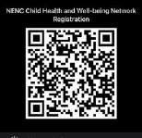

North East and North Cumbria’s Child
Health and Wellbeing Network
Feel free to Tweet throughout
@EveryChildNENC
and join our Network here via the QR code
Follow us @EveryChildNENC

Slide 2
Child Health and Well Being Network NENC
Asthma Leadership Group ( NENC ICS) Dr Samantha Moss (Clinical Lead)
Mrs Louise Dauncey (Delivery Manager)
Dr Neelmanee Ramphul (Consultant Paediatrician ) Dr Ahmed Hegab (Consultant Paediatrician)
Carol Barwick (Lead Community Asthma Advisor) Dr Andrew Bright ( Anaphylaxis)

Slide 3
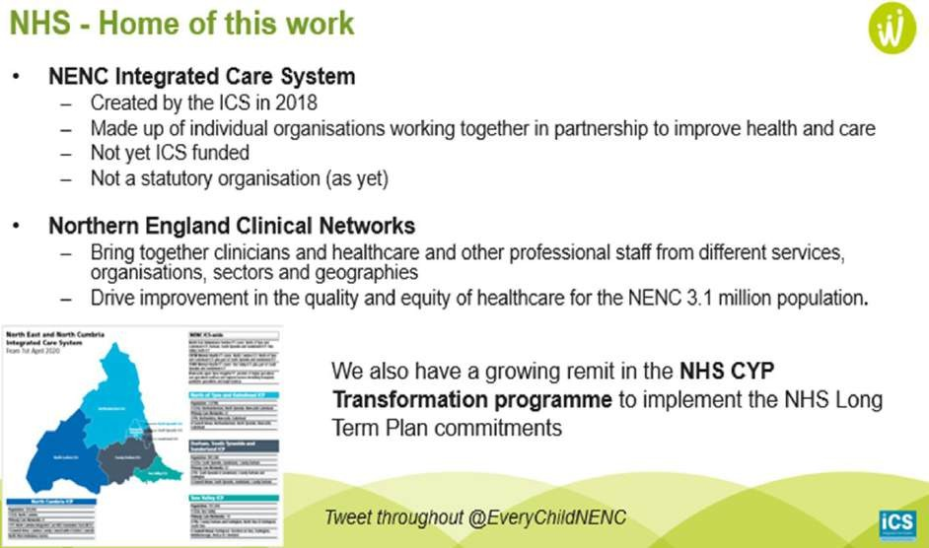
Child Health and Well Being Network NENC

Slide 4
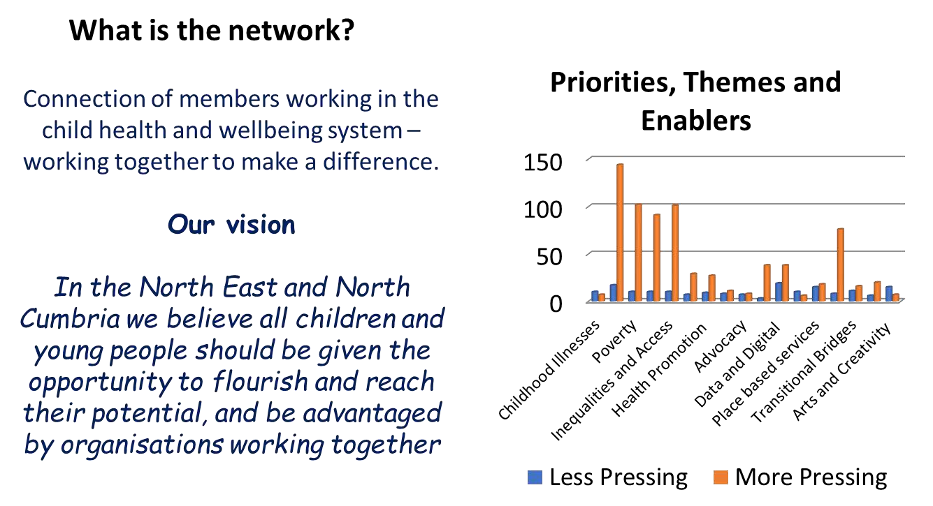
Child Health and Well Being Network NENC

Slide 5
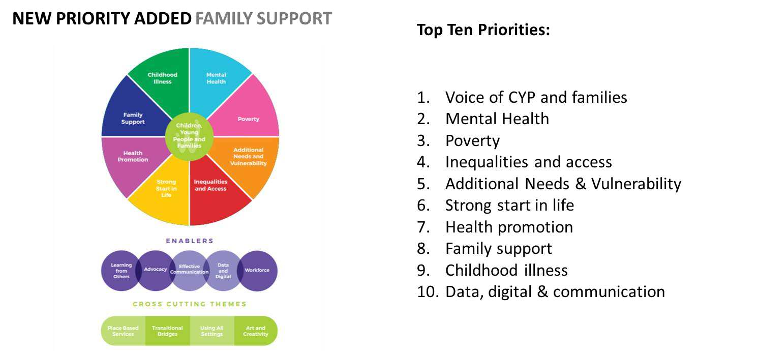
Child Health and Well Being Network NENC

Slide 6
Asthma
5.4 million people who suffer from Asthma in the UK
1.1 million children
Common chronic disease in children
Outcomes for children in the UK amongst the worst in the West
Outcomes even worse in the North East

Slide 7
What do we know already?
National Review of Asthma Deaths (NRAD) report (2013)
  28 deaths in young people < 19 years old
20 to 30 children continue to die per year
State of Child Health Report, Royal College of Paediatrics and Child Health
(RCPCH): UK Asthma deaths (2017)
  17 deaths (0-14 years old)
  22 deaths (5-24 years old)
Healthcare Safety Investigation Branch (HSIB) Report :May 2021
Ongoing National Asthma and COPD Audit Programme (NACAP) Audit looking at care in hospital

Slide 8
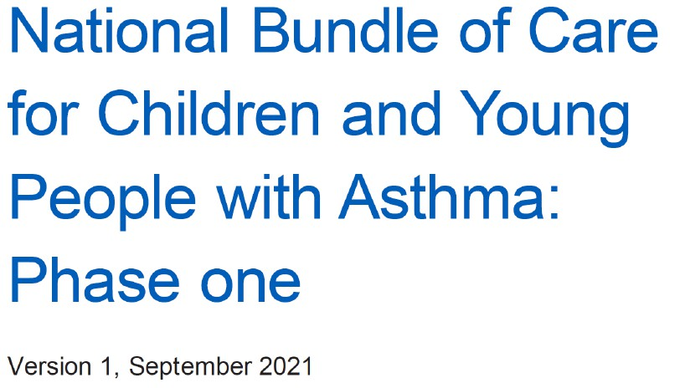

Slide 9
Focus of National Asthma Bundle
Whole system approach
Organisation of care and leadership
Environmental Impacts
Accurate and Early Diagnosis
Effective Preventative Medicine
Managing Exacerbations
Severe Asthma
Competencies/Training and Education Needs
Data and Digital

Slide 10
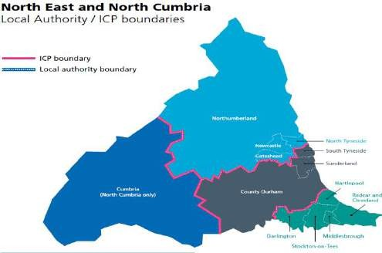
Primary Care Survey
104 responses from across the region
Online ( MS Forms)
20th December 2021 to 13th February 2022
Average completion time 10.5 minutes
Return rate of about 18%(around 570
GP Practices in NENC)
All areas represented

Slide 11
Demographics of Respondents
Role
other, 23%
Practice/Asthma
Nurses,…
GPs, 18%

Slide 12
Organisation and Leadership
13% of respondents had a lead role within the CCG or Primary Care Network
39% had a designated lead for Children and Young People
67% had a lead for respiratory conditions in general
39% have a link pharmacist

Slide 13
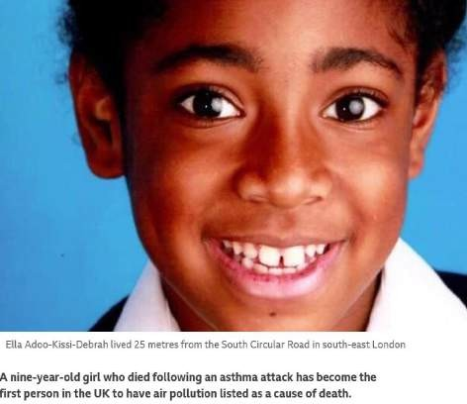
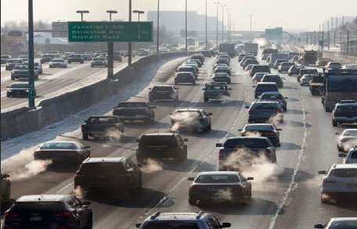
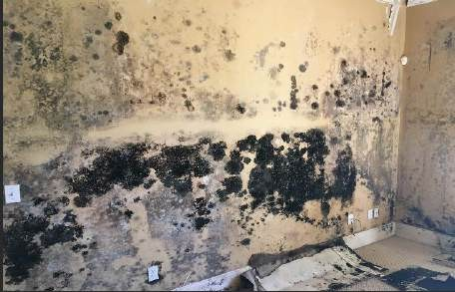

Environmental Impacts

Slide 14

Environmental Impacts
76% of respondents recorded a smoking history in the household routinely

Slide 15

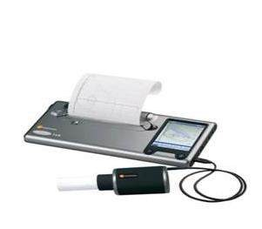
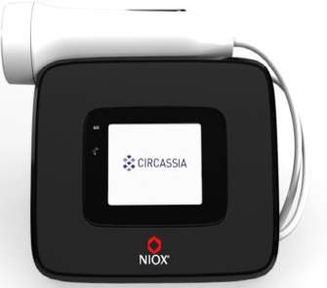
Accurate and Early Diagnosis

Slide 16
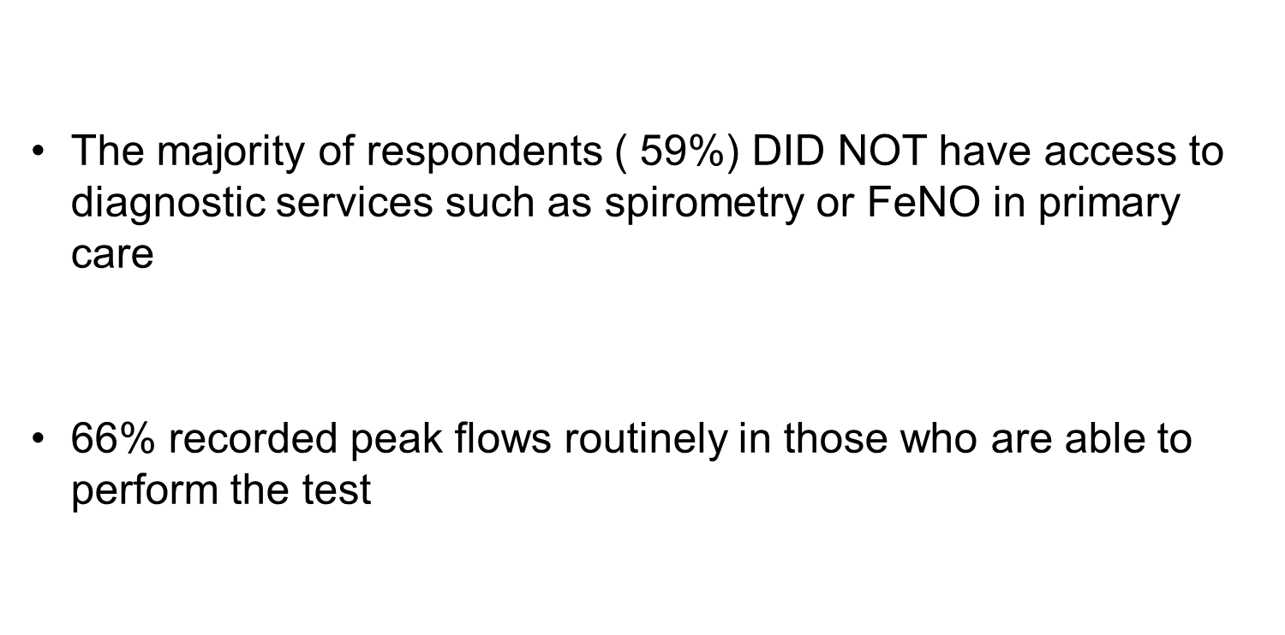
Accurate and Early Diagnosis

Slide 17
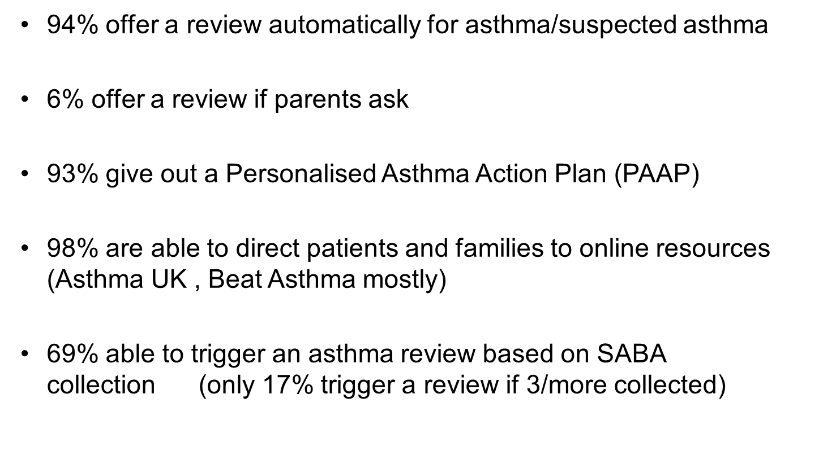
Prevention

Slide 18
Managing Exacerbations
Majority ( 85%) aware that a 48 hours review is recommended post discharge after hospital attendance
Only 63% able to offer it
Main reasons:
  CAPACITY
  Sometimes communication raised as an issue (especially if seen on a Friday evening)

Slide 19


Severe Asthma
Of those who identified themselves as leads, 67% were aware that they
can refer directly into a severe asthma service in tertiary care if needed

Slide 20
Training and Education
Most respondents ( 66%) were not aware that the National Asthma Bundle had been published
18% had access to paediatric asthma training ( 7% able to access yearly or more frequently than yearly)
The majority of respondents referred to BTS /SIGN and NICE
guidance when needed

Slide 21
Data and Digital
61% had a guideline/policy of when to refer into secondary care
50% audit how many annual reviews are conducted
39% audit the number of patients who have a PAAP
28% audit the number of courses of oral steroids prescribed per patient per year and the number o unscheduled hospital attendances per patient per year
11% audit the number of 48 hours review conducted
39% have a link pharmacist who can monitor SABA collection

Slide 22
Positive Findings in Primary Care
Good use of PAAP
Annual review offered to the majority
Families are being directed to web based resources
Awareness of the importance of the 48 hours review

Slide 23
Areas for Improvement
Better access to Paediatric Asthma Training
Better access to diagnostic service
An URGENT need to address SABA overuse both to improve disease control and for sustainability
Better concordance check
A strategy to facilitate 48 hours review
Utilise every opportunity to deter smoking and exposure to
smoking

Slide 24

So, what next?

Slide 25
Training and Education
Working closer together to run education sessions/ training
days across the North East and Cumbria
Understanding barriers
Exploring motivation to engage in further training across the board
Embed National Training Initiatives

Slide 26

Training and Education

Slide 27
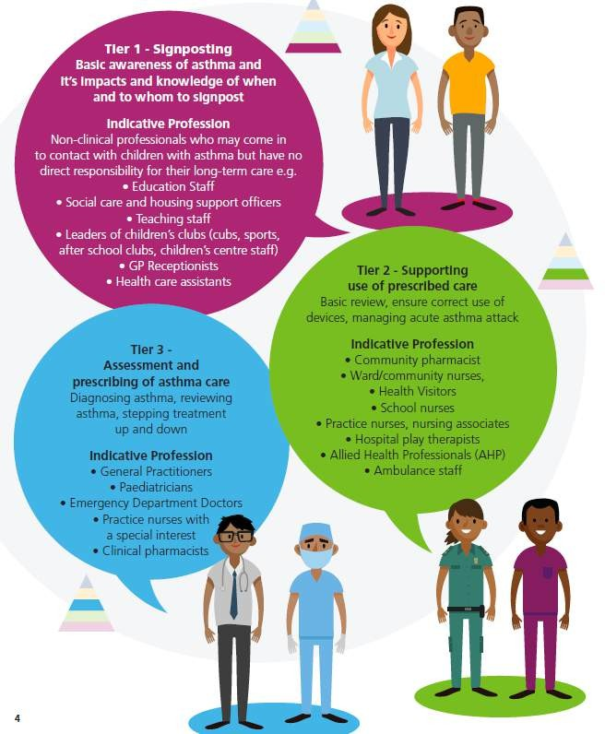
Training and Education

Slide 28
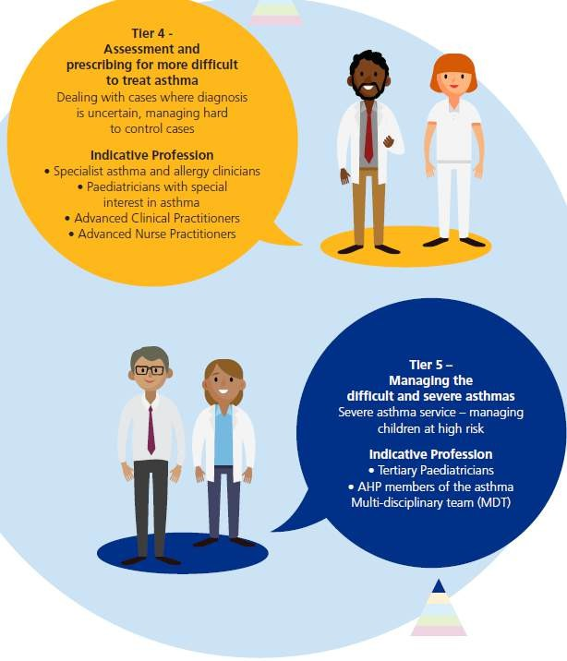
Training and Education

Slide 29
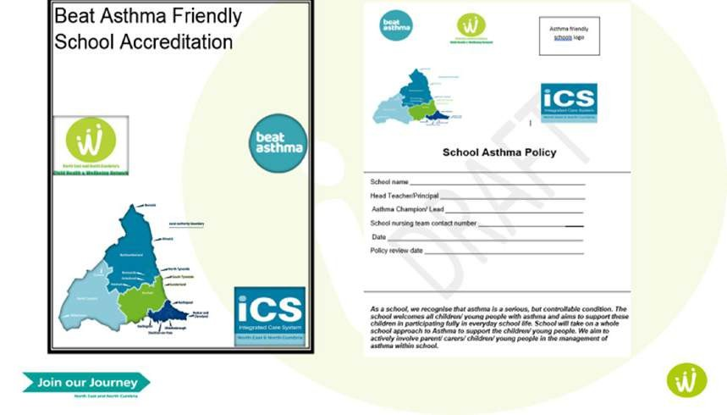
Beat Asthma Friendly Schools Criteria

Slide 30



Maximise use of Regional Resources

Slide 31





Recommended Resources For Asthma
https://www.beatasthma.co.uk/
https://www.nenc-
healthiertogether.nhs.uk/
https://www.asthma.org.uk/
https://www.itchysneezywheezy. co.uk/

Slide 32

Conclusion
Our role is to promote and work together to help embed the National Bundle Of Care for CYP with Asthma

Slide 33

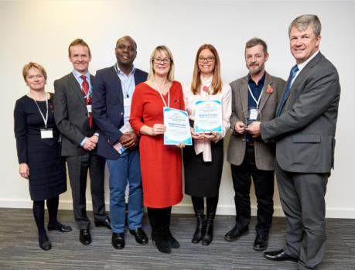
Thank you and stay in touch
Please follow, share and retweet relevant work so that we can continue to share good practice across the region at the child health and wellbeing network handle @NorthNetChild
Visit our website - https://nhsjoinourjourney.org.uk/what-we-are- doing/priorities/optimising-health-services/child- health-and-wellbeing-network/
Please encourage colleagues from all areas of the child health and Wellbeing Network to register with england.northernchildnetwork@nhs.net so they are included in our communications and feed into the workplan projects that they are interested in.

