Slide 1

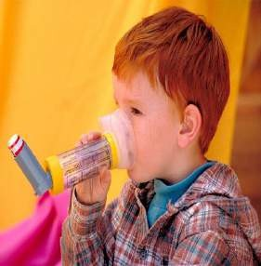
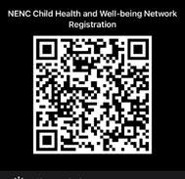

Beat Asthma Friendly Schools Accreditation.
Carol Barwick Clare Caygill Nichola Jackson
Community Asthma Advisors
North East and North Cumbria’s Child Health and
Wellbeing Network
Feel free to Tweet throughout @EveryChildNENC and join our Network here via the QR code
Follow us @EveryChildNENC

Slide 2
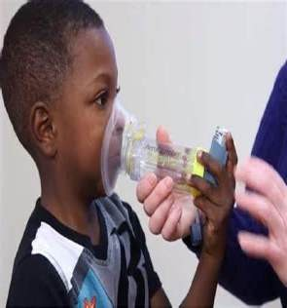
Asthma
Asthma is the most common long term medical condition in children and young people.
Around 1 in 11 children live with asthma.
Outcomes for children and young people living in deprived areas are worse.
The UK has one of the highest emergency admission rates for asthma in Europe.
There are over 25,000 emergency hospital admissions for asthma amongst children a year in the UK.
Asthma is a main contributor to school days lost.
(National bundle of care for children and young people with asthma September 2021. )

Slide 3

Effects of Asthma on Education
Children with persistent, uncontrolled or severe asthma are more likely to miss school, compared to children with mild asthma.
Children who have been in hospital for asthma had more time off school and this is the likely cause of their poorer educational attainment particularly KS1
Research shows having a diagnosis of asthma is a risk factor in dropping a grade between mock and final exams.
Uncontrolled asthma can lead to decrease academic performance
Every September, more children are rushed to hospital due to their asthma than at any other time of the year.
Research studies suggest that asthma is responsible for up to 18% of school absences, with evidence improved asthma control improves school attendance and performance.
A Survey found that 86% of children with asthma have at some time been without an inhaler at school.

Slide 4
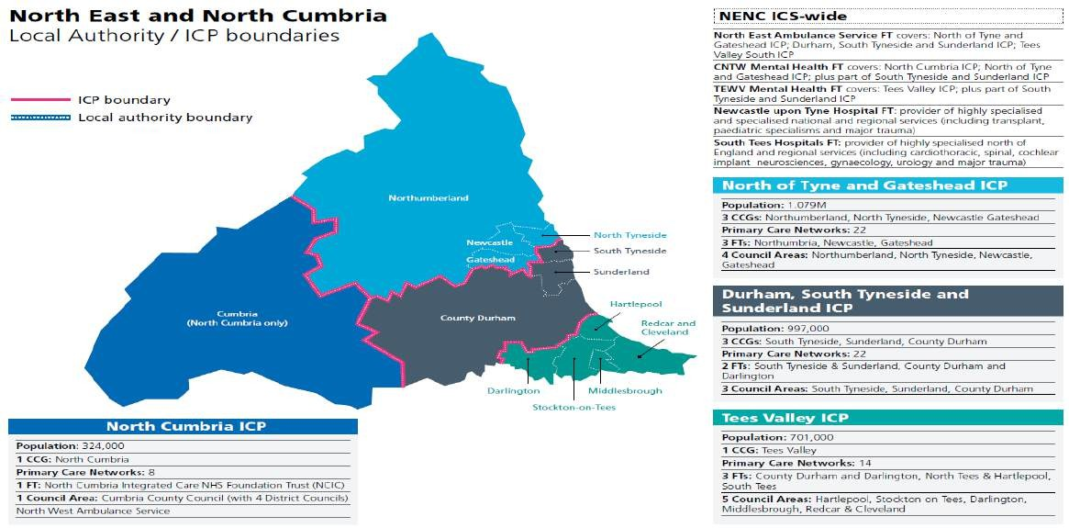
North East and North Cumbria Integrated Care System

Slide 5

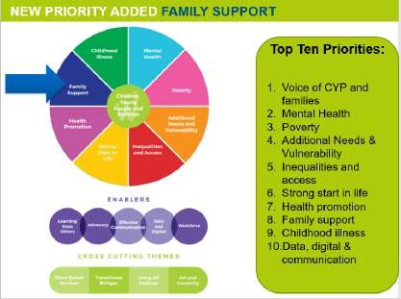
NHS England and NHS Improvement ambition is to reduce avoidable harm to children and young people from Asthma and improve the quality of life.
Taking a whole system approach to asthma management.
Addressing environmental tiggers
Education programme
Personalised care ( individual asthma plan/known as PAAP)
Effective preventable medicine
Improved accuracy of diagnosis
(National bundle of care for children and young people with asthma September 2021. )

Slide 6
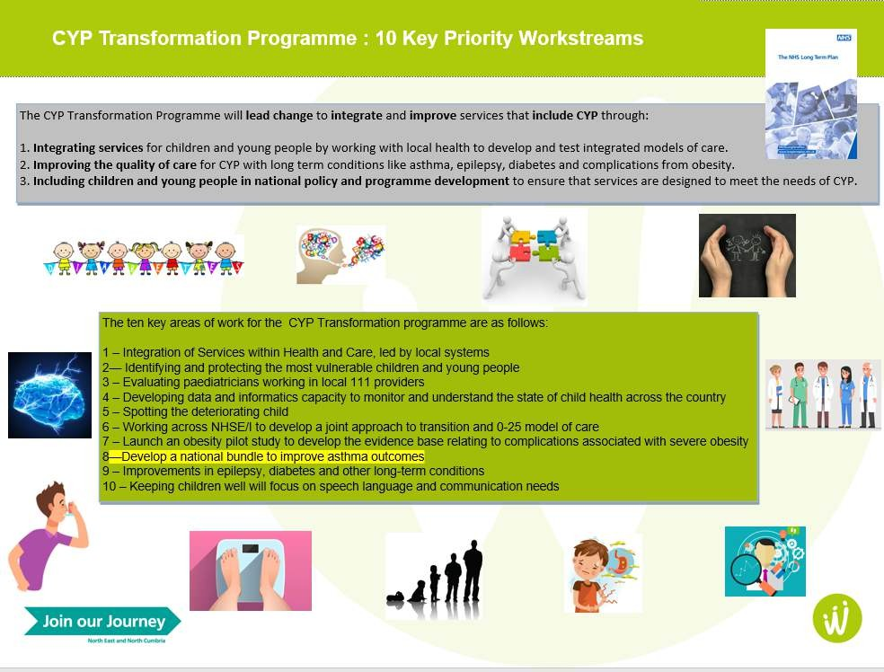

Slide 7
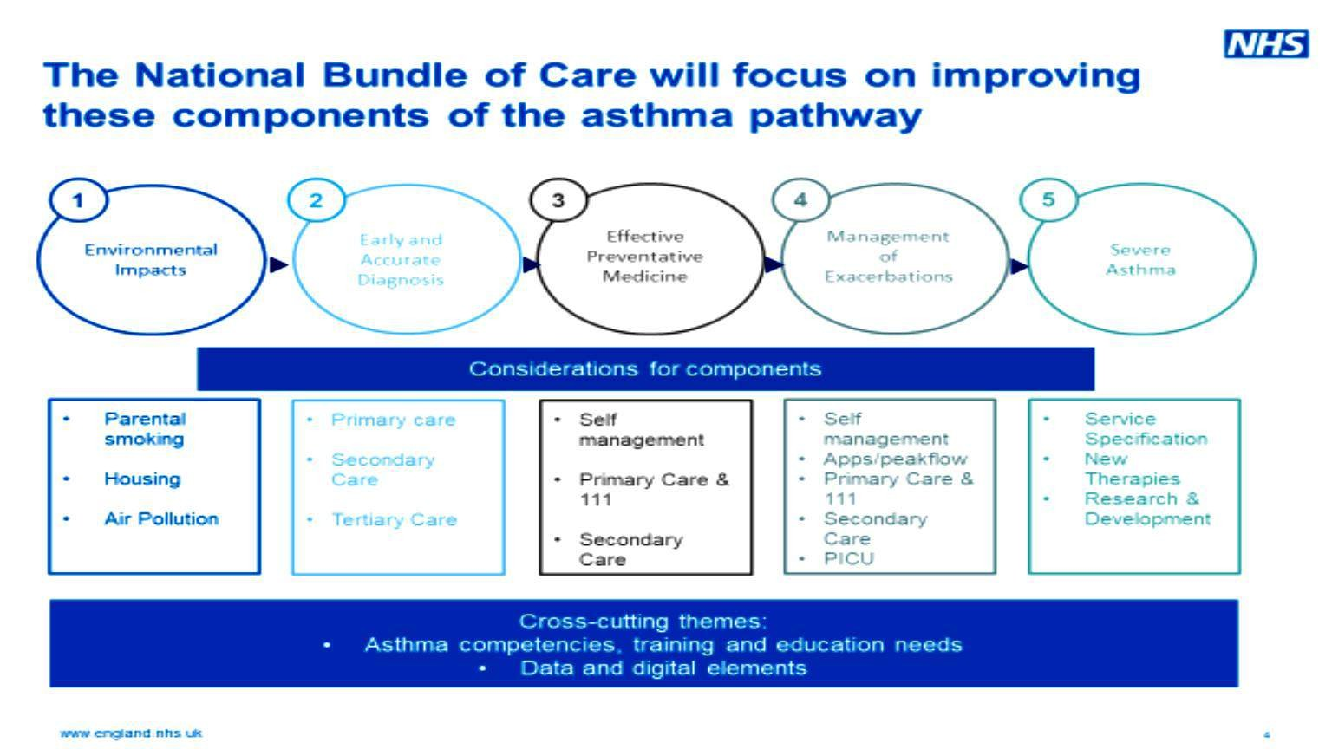
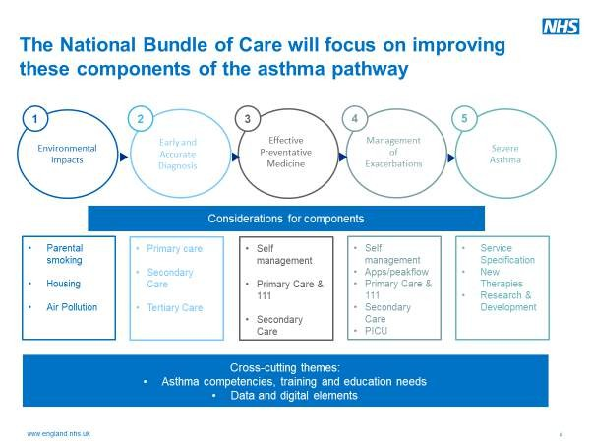

Slide 8
Asthma & Allergy/ Anaphylaxis Education Survey
results January 2022
198 responses (from approximately 1440 schools) all ICS area contributed.
The survey was completed by various school team members.
Half the results were from Primary Schools.
Over 70 schools said they did not have an asthma policy .
69 Schools did not have a asthma lead.
111 schools would like further training.
125 schools would like to explore the possibility of being a asthma friendly school.

Slide 9

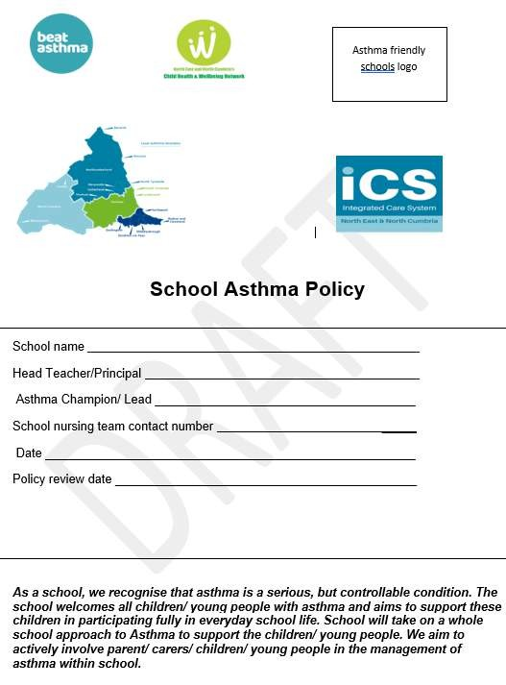


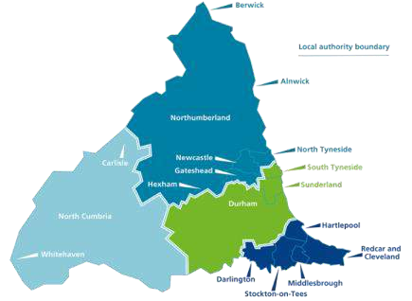

Beat Asthma Friendly Schools Criteria
Beat Asthma Friendly School Accreditation

Slide 10
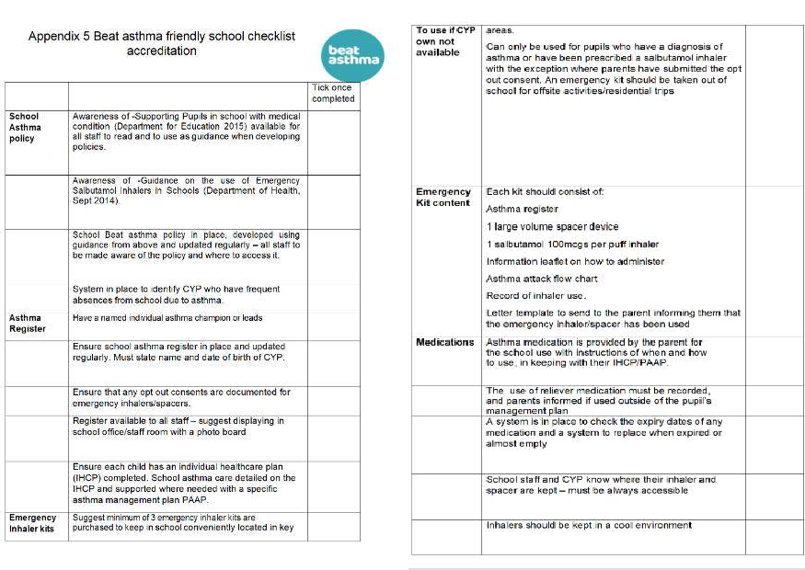
Beat Asthma Friendly Schools Accreditation

Slide 11
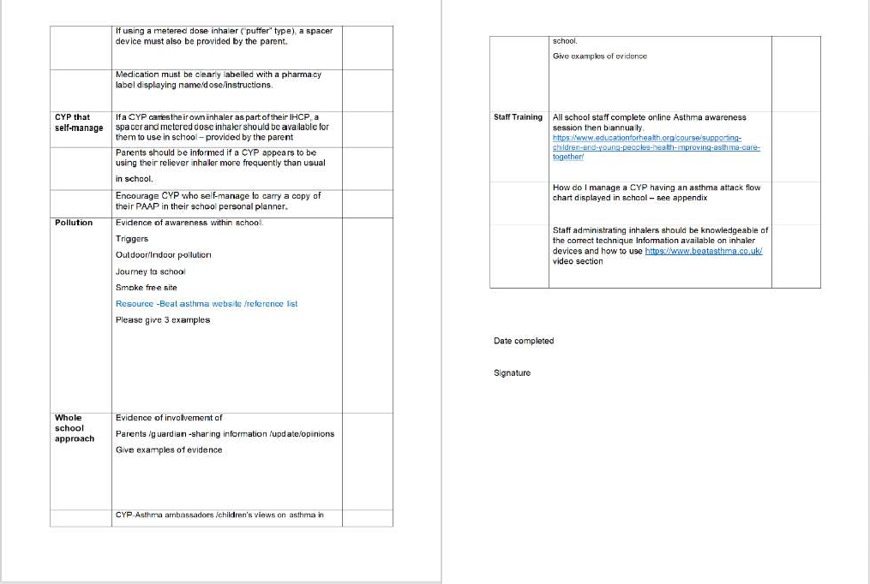
Beat Asthma Friendly Schools Accreditation (contd)

Slide 12
Who will be Involved
Parent/ Care
CYP
Asthma nurse specialist/ Paediatricians Hospital
Children and Young people
Education (asthma friendly schools)
Gps /practice nurses
Health School nurses/ Health visitors
/ community
nurses
Social care

Slide 13
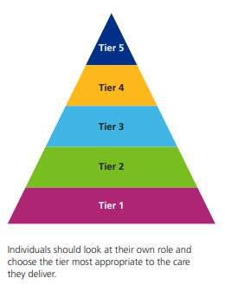

Asthma Awareness Sessions
Individuals and professionals will be divided into to different Tiers for awareness sessions.
Tier 1 session includes a 45 minutes online session with multiple choice question to check the individuals knowledge and understanding. This training is free to complete.
Tier 1 Social care, housing support officers, teaching staff and leaders of children’s clubs (cubs, sports, after school clubs, children’s centre staff)
Different tiers will have different requirements for the training/ awareness required.
Education awareness session link Tier 1
https://www.educationforhealth.org/course/supporting-children- and-young-peoples-health-improving-asthma-care-together/

Slide 14

Next Steps for Beat Asthma Friendly Schools
Task and Finish group meeting19/07/22
Regional Beat asthma friendly schools policy uniformity across the
whole ICS area
Beat asthma friendly schools pilot Primary whole ICS, Secondary
Gateshead area from September 2022
Review pilot and adapt as needed.
Develop timeline following Beat asthma friendly school
pilot to roll out to all ICS areas.

Slide 15
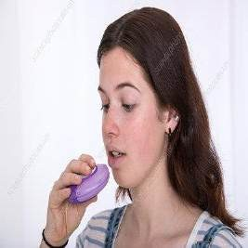
Any Questions ?
Thank You
Please help us to improve asthma care for children and
young people.
Asthma friendly schools logo

Slide 16
Resources/ References
https://www.england.nhs.uk/publication/national-bundle-of-care-for...
National bundle of care for children and young people with asthma
National bundle of care for children and young people with asthma: resource pack
Beat Asthma https://www.beatasthma.co.uk
NICE guidance (2017)
https://wwwAsthma + Lung UK (blf.org.uk).evidence.nhs.uk/search?q=ASTHma+guidelines+in+children
BTS Sign (2019)
https://www.brit-thoracic.org.uk/document-library/guidelines/asthma/...
National-Capabilities-Framework.pdf (e-lfh.org.uk)
Healthier together
Home :: Healthier Together (what0-18.nhs.uk)
Asthma and Lung UK
Asthma + Lung UK (blf.org.uk)

Slide 17

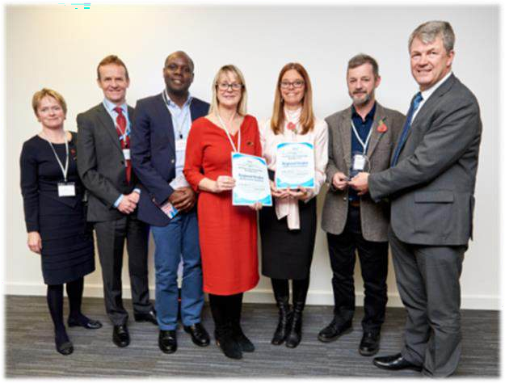
Thank you and stay in touch
Please follow, share and retweet relevant work so that we can continue to share good practice across the region at the child health and wellbeing network handle @EveryChildNENC
Visit our website - https://nhsjoinourjourney.org.uk/what- we-are-doing/priorities/optimising-health-services/child- health-and-wellbeing-network/
Please encourage colleagues from all areas of the child health and Wellbeing Network to register with england.northernchildnetwork@nhs.net so they are included in our communications and feed into the workplan projects that they are interested in.

