Slide 1

Child Health and Wellbeing Hot Topics in Paediatric Asthma
Primary Care Webinar (3)
Please stay on mute throughout the meeting, unless actively taking part in the discussion. Do feel free to use the chat facility and raise your hand to enable us to facilitate the discussion, we will be allowing opportunities for questions/discussion and interaction throughout.
Please note-this webinar will be recorded and shared with other primary care colleagues upon request
If you have any queries- please get in touch with the Team via Chat
March 2024
Notes:
Hello and Welcome to the CHWN Webinar about Paediatric Asthma for Primary Care colleagues. Thank you so much for joining us for our 3rd Asthma Webinar for Primary Care Teams.
This session will be recorded
A few points of Housekeeping
Please stay on mute and turn your camera off throughout the session, unless actively taking part in the discussion. We are a sizeable group!
If participants could try not to take control of the slides during the session this would be really appreciated, the speakers will move through the slides as they deliver their presentations, all slides will be shared following this session.
It would be a really great help if people could list in the chat the practice that they are representing and the geographic locality so we can get a sense of the reach for this session
Do feel free to use the chat facility and raise your hand to enable us to facilitate the discussion. Please note that we will be sharing this so to remind colleagues about confidentiality when discussing practical application
Colleagues from the Asthma Leadership Group will be responding within the chat function throughout
We have included an opportunity for interactive discussion throughout and professionals from the team will respond to any questions or comments that airse
Any questions that remain unanswered the team will attempt to respond to following the conclusion of the webinar, or if any colleagues have questions after the event has concluded we will monitor and update the chat for a further 24 hours
NEXT SLIDE

Slide 2
Welcome and Introductions
Beat Asthma and the National Bundle of Care for Children Young People with Asthma
NENC CHWN ICS Asthma Leadership Group
Dr Samantha Moss (Clinical Lead)
Dr Neelmanee Ramphul (Clinical Advisor)
Dr Ahmed Hegab (Clinical Advisor)
Carol Barwick (Lead Community Asthma Advisor)
Clare Caygill (Community Asthma Advisor)
Sarah Wilkinson (Community Asthma Advisor)
Helen Ramm (Community Asthma Advisor)
Sophie Beckham (Community Asthma Advisor)
Bethany Angus (Community Asthma Advisor)
Louise Dauncey (Delivery Manager)
Dr Andrew Bright – Clinical Lead – Allergy and Anaphylaxis
(Primary Care and Education Advisors and CHWN System Leaders – CIC Fellows)
Notes:
So by way of introduction then, my name is Louise Dauncey and I am a Network Delivery Manager, my main role and responsibility is for the delivery of the CYP Transformation Programme here in the North East and North Cumbria.
Im here on behalf of the Child Health and Wellbeing Network and the NENC ICS Asthma Leadership Group
Dr Moss, Dr Ramphul, Dr Hegab and Carol Barwick will lead the sessions with presentations and discussion, everybody will introduce themselves as part of their presentations.
The list above provides the names of other current members of the Asthma Leadership Group –we have a wide range of disciplines ranging from respiratory nurse specialists to 0-19 school nursing and pharmacists
NEXT SLIDE

Slide 3
Proposed Agenda
Welcome and Introductions – Louise Dauncey
CHWN introduction – Louise Dauncey - 5 minutes
Making a diagnosis in the absence of Spiro/FENO – Dr Ramphul – 10 minutes
Discussion – All – 5 minutes
Choice of Inhaler – Carol Barwick – 10 minutes
Discussion – All – 5 minutes
Overuse of Salbutamol - Dr Moss – 5 minutes
Discussion – All – 5 mins
When to refer to and NENC pathway – Dr Hegab – 10 minutes
Discussion – All – 5 minutes
Close – Louise Dauncey
Notes:
Our agenda for this evening is described here
4 sessions to cover diagnosis in the absence of objective testing, choice of inhaler, overuse of salbutamol and the final session on when to refer and the NENC pathway.
We will try to keep to time this evening in order to facilitate discussion time following each slot
NEXT SLIDE

Slide 4
Who are we and what do we do?
Connection of members working in the child health and wellbeing system – working together to make a difference.
Our Vision
“In the North East and North Cumbria we believe all children and young people should be given the opportunity to flourish and reach their potential, and be advantaged by organisations working together”
Notes:
I just wanted to spend a few minutes at the beginning of the session to provide some background and context to the work and to describe:
Who we are and what we do
the evolution of the Child Health and Wellbeing Network
Mandate and the System asks – our priorities
Where we are today
Broadly speaking the CHWN provides a platform to enable collaboration and connections of stakeholders across the system to make a difference to YP and their families
NEXT SLIDE

Slide 5

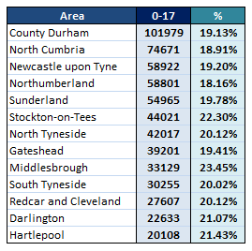
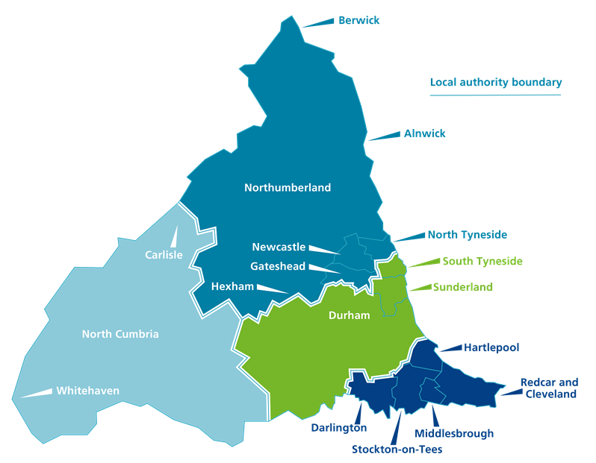

Populations
18%
20%
19%
19%
20%
19%
19%
19%
21%
21%
22%
20%
23%
Data Source – https://www.ons.gov.uk/
Notes:
I wont go in to detail as time is short, this slide just provides local context and CYP population data and also gives an indication of the size of our geography,
The map on the right shows the 4 area ICP (Integrated Care Partnerships) of the NENC ICS also marks out the 13 Local Education Authority boundary areas that we cover which includes 13 Local Authorities, 13 Public Health Authorities, 8 acute trusts, 2 Mental health Trusts and 3 ambulance Trusts as well as numerous Primary Care Networks.
You will appreciate also that the education system forms a valuable part of our ICS and within this consider the 1400+ schools and education settings across our huge geography.
ICB operates across wide geography and diverse population – wide ranging socio economic challenges. As a professional working in this area I am sure that you will be well aware of the socioeconomic challenges locally and the impact of this on health and other outcomes on our CYP population
You will also be aware of the Core 20 plus 5 framework and the recognition of asthma as a clinical area of additional vulnerability
NEXT SLIDE

Slide 6

Network priorities
Our vision
In the North East and North Cumbria we believe all children and young people should be given the opportunity to flourish and reach their potential, and be advantaged by organisations working together
What do you want us to do
“Share good practice, drive work forward and connect us into experts and groups”
Notes:
Initial stakeholder engagement which included over 1000 points of contact with stakeholders and families when the network was established historically has given us a range of priorities and areas of need and this is represented here in this colorful wheel
I wont go in to detail however for those colleagues who are living and working in our local geography none of these areas of priority will be a surprise given the known levels of deprivation and various challenges that we have locally for families
Within this we have a growing role in relation to the CYP Transformation agenda – particularly in relation to additional needs and vulnerability and childhood illness
The CHWN has an overriding vision which holds CYP at the centre of all we do and our mission statement here on the slides outlines our belief that CYP should be give opportunities to flourish
This should be enabled by systemwide organisations working cohesively
Our role within this is about sharing good practice and driving improvement and enabling platforms for connection
Our network is growing and has broad representation from across the system and childrens workforce, we currently stand at over 1900 members
NEXT SLIDE

Slide 7

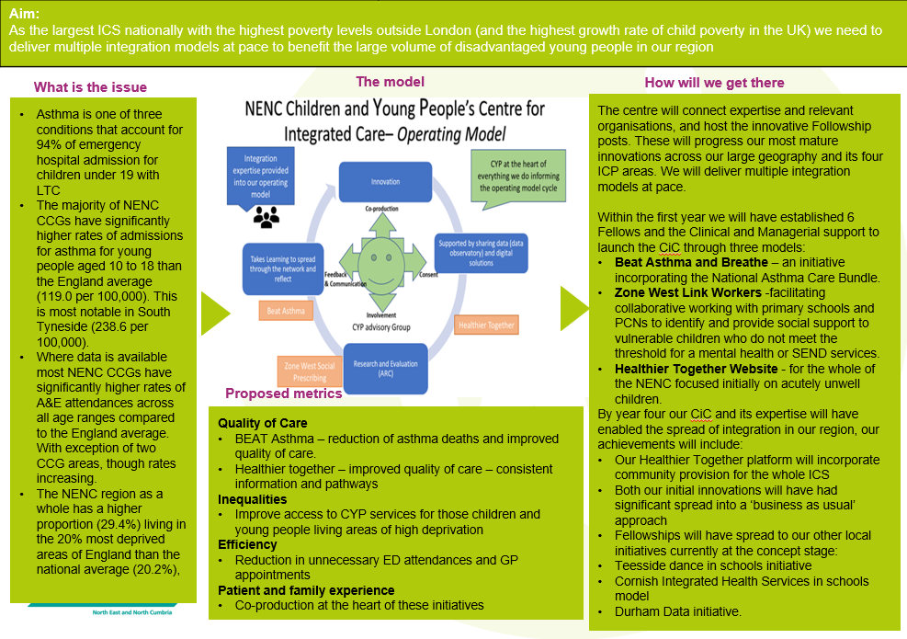
Child Health and Wellbeing Work
Youth Voice
Health Inequalities
Communications
CYPT Programme
CYPT Integration Centre
Notes:
The CHWN has multiple strands of work including
-Youth Voice
-Health Inequalities including Core 20
-A programme of communications, engagement and training opportunities
-Delivery of the CYPT Programme
And
-The NENC CYPT Integration Centre
The CYPT programme has 3 main aims in relation to the
-integration of services
- improving quality of care, outcomes and experience for CYP and their families
- the more ready and active involvement of CYP
Within this there are 10 key areas of work relating to the NHS Long Term Plan. LTC and Asthma are identified as a priority.
The CYPT Integration Centre – is a pilot project in the NENC with a number of key components, one of which is the roll out of systemwide education based intervention to improve community capacity and support the wider system with improved asthma management for our children and Young people
The aims and objectives of the CYPT Programme and the Integration Centre closely align with the Vision for the CHWN
NEXT SLIDE

Slide 8
Asthma : Roll out National Bundle of Asthma Care/ Integration Centre: Systemwide Education Based Intervention
Our Achievements:
Project underway to bring together Beat Asthma and roll out of national bundle
Mutli-disciplinary team in place until March 24
Systemwide survey and stakeholder engagement focus group sessions
Baselining project complete, report published
Progress report published here
Further baselining questionnaire into Community Pharmacy
Working with the LTCPH Network and with NENC Respiratory Group
Standardised educational resources have been developed – TITO/Heads/Senco
Presented at TITOs, Heads and SENCOs forums, Schools North East, Ambulance Service, MCN and RIG – various others
Targeted work into primary care services
Pathways and resources developed primary to secondary and secondary to tertiary
Accreditation Framework and Schools policy developed
Schools Accreditation Pilot completed, 13 schools on board in pilot (3952 children on roll).
Roll out of BAFS.
Schools logo competition – Children’s voice in asthma
Northumbria sustainability short film
#AskAboutAsthma2022 Podcast
Webinars delivered Jan/Feb 23 Asthma webinars | Resources | Healthier Together | (nenc-healthiertogether.nhs.uk)
Conference delivered June 23 1st Northeast and Cumbria Paediatric Asthma and Allergy Conference - Tuesday 6th June 2023 - South Tees Conferences and Events
Conference resources published
Professionals/Schools/Community Resources developed and published
ODN Education Session Sept 23
SNE Webinar Nov 23
RCPCH submission Dec 23
Asthma Huddle Dec 23
For more information contact Louise.dauncey1@nhs.net
The Impact:
Most listened to podcast #Ask About Asthma Oct 22
2000+ points of contact so far across system
Elearning for Health online training (Level 1) has significantly increased and 90% of the training undertaken has been by education colleagues
Increasing uptake for Level 2 – 150 individuals have undertaken training (50% from hospital settings)
There has been less non elective activity since the commencement of this programme than previous indicative years
17 practices and 30+ community pharmacy settings report overall improved awareness of the bundle, inhaler choice and disposal and confidence to completing annual asthma review
Primary Care webinars 350 combined attendees 1500 downloads
Referral Pathways and Resources 2500 downloads
Schools reported 92% increase in confidence within pilot group to effectively manage CYP with asthma, 100% positive feedback about the accreditation resources and c30 examples of good practice and/or changes in practice in school settings. 42% of settings reported a reduction in school days lost.
Plans and Priorities – Key Focus 23/24:
Further roll out of the asthma friendly school accreditation in primary settings and roll out in secondary settings
To address sustainability of asthma friendly school accreditation across NENC
Improve secondary care acute exacerbation outcomes
Identify target areas in primary care and further targeted interventions
Complete pharmacy 2 day review pilot
Develop asthma friendly sports club accreditation
Build better links with housing to address NACB
On-going education re NACB and training resources available through existing networks
Notes:
In the NENC through the Integration Centre we have resourced an Asthma Leadership Group with a range of fellows and a workforce to deliver a range of activities across the system.
Examples of this include the various points of contact with professionals across the system and targeted work into primary care and community pharmacy as well as into education settings, sports clubs, Local Authorities and the Housing Sector
This slide describes some of the parallel bits of work ongoing in relation to asthma into various parts of our complex health, social care and education system.
Alongside this we have developed a host of resources which are hosted on the NENC HT website. There are links included on the slide which will be shared so participants can view these at their leisure.
My email address is on the slide for more information or further discussion. All slides will be shared following the event
NEXT SLIDE

Slide 9
Thank you !!
Please follow, share and retweet relevant work so that we can continue to share good practice across the region at the Child Health and Wellbeing Network handle @EveryChildNENC Visit our website - Child Health and Wellbeing Network | North East and North Cumbria NHS (northeastnorthcumbria.nhs.uk) Please encourage colleagues from all areas of Child Health and Wellbeing to register via forms.gle/gG11zhr2Z8VLU2db9 so they are included in our communications and feed into the workplan projects that they are interested in.
Notes:
That’s it from me regarding the CHWN, would encourage you to look at our website to find out more about our various projects
If you aren’t a member please do sign up, we share updates on a weekly basis and provide opportunity for all sorts of engagement discussion etc – the link here takes you to the sign up form
I will hand now to Dr Ramphul to lead the first session on making a diagnosis of asthma in the absence of spirometry or FENO.
Dr Ramphul is a Consultant Paediatrician at Queen Elizabeth Hospital and also is a Clinical Advisor to the CHWN, she has a passion for working collaboratively to support improvements in care and outcomes for Children and Young People who suffer from Asthma
NEXT SLIDE

Slide 10
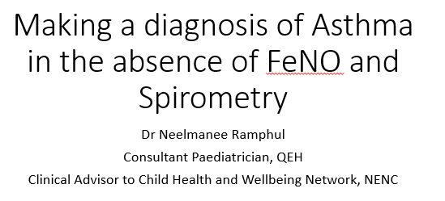

Slide 11
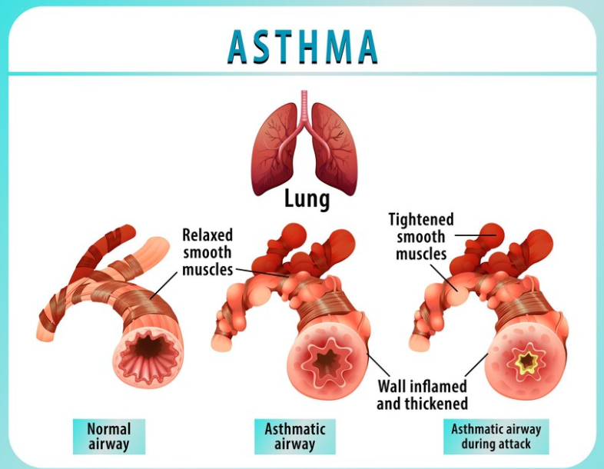

Slide 12
What clinical features support a diagnosis of asthma (BTS/SIGN)?
Recurrent symptoms of cough, wheeze, SOB (especially if corroborated by variable peak flows)
Wheeze heard by a health professional
Family History/ Personal history of atopy
Response to bronchodilators and/or oral or inhaled steroids
No symptoms or signs to suggest alternative diagnoses

Slide 13
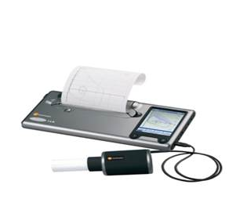

What are we trying to demonstrate with objective testing?
Airway Obstruction
Reversibility
Inflammation/ airway eosinophilia(FeNO)

Slide 14

What supports a diagnosis of Asthma?
Peak flow variability suggestive of asthma
12% (BTS/SIGN, ERS)
13% (GINA)
20% (NICE)
Spirometry
FEV1/FVC ratio
<70% (BTS/SIGN, NICE) or <LLN (lower limit of normal)
<80% (ERS) or <LLN
<90% (GINA) or <LLN
An improvement of at least 12% in FEV1 to either beta 2 agonist or corticosteroid treatment considered positive
High FeNO
25 ppb and above ( ERS)
35 ppb and above ( BTS/SIGN,NICE)

Slide 15
Limitations of Objective testing
Difficult to perform in young children
Can be normal in children ( especially when asymptomatic)
FEV1/FVC ratio variable ( can be as high as 90 % ; cut off of 70% may miss cases)
Technique dependent ( both patient and operator dependant)
FeNO can be raised in other inflammatory conditions such as allergic rhinitis

Slide 16
Pragmatic Approach in the absence of Spirometry/ FeNO
BTS/SIGN Guidelines ( 2019)
Diagnosis is based on clinical features
High probability
Intermediate probability
Low probability
ACT scores before and after treatment ( 19 and above good control)
Consider trial of treatment with ICS for at least 6 weeks
Demonstrate peak flow variability where possible
- Diurnal variation
- drop with exercise ( 10 to 15%)
- 12 %increase post SABA or corticosteroid treatment
Review progress

Slide 17
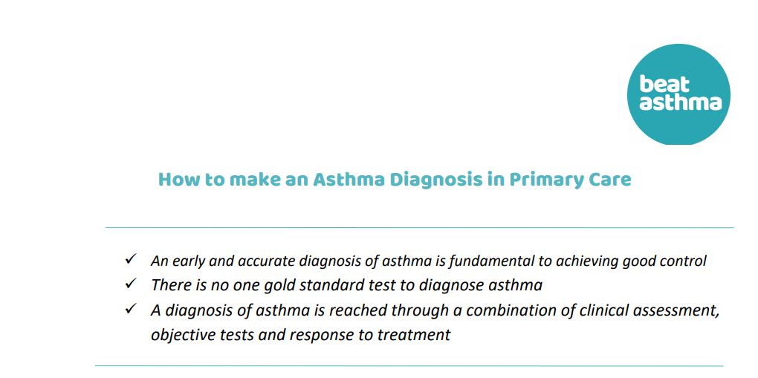
Microsoft Word - How to make an Asthma Diagnosis in Primary Care june 22.docx (beatasthma.co.uk)

Slide 18
Further Reading
Challenges in diagnosing asthma in children
Kendra Chisholm, paediatric trainee1, Luke Daines, GP2, Steve Turner, consultant paediatrician
¹Women and Children’s Division, NHS Grampian, Aberdeen, UK
²Usher Institute, University of Edinburgh, Edinburgh
BMJ 2024; 384 doi: https://doi.org/10.1136/bmj-2023-075924 (Published 13 February 2024)

Slide 19
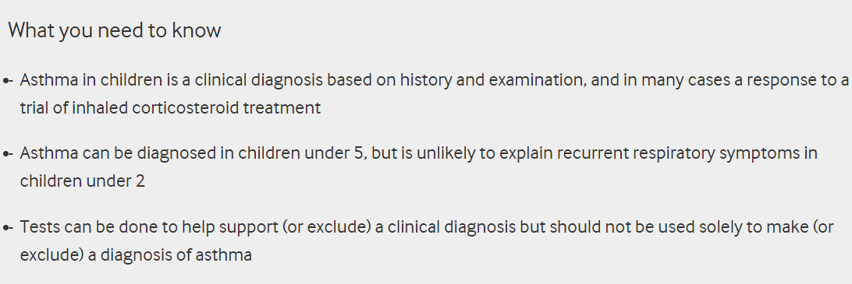
BMJ 2024; 384 doi: https://doi.org/10.1136/bmj-2023-075924
(Published 13 February 2024)

Slide 20
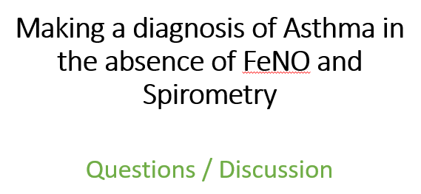
Notes:
Thanks for providing that helpful information for our group, can I open the floor to questions / comments and discussion we have a couple of minutes now to provide interactive feedback……

Slide 21

Notes:
Great ok, thank you all very much
Moving on then, we will now hear from Carol about inhaler choices for children and young people
Carol is a Children’s Respiratory Nurse Specialist at James Cook hospital and is the lead Community Asthma Advisor to the CHWN, Carol along with the other Community Asthma Advisors has progressed a huge amount of work to support to improve asthma care for young people as part of the NENC Asthma Leadership Group
Over to you Carol

Slide 22
Inhaler choices for CYP Carol Barwick Respiratory Specialist Nurse – STHFT Lead Community Asthma Advisors

Slide 23
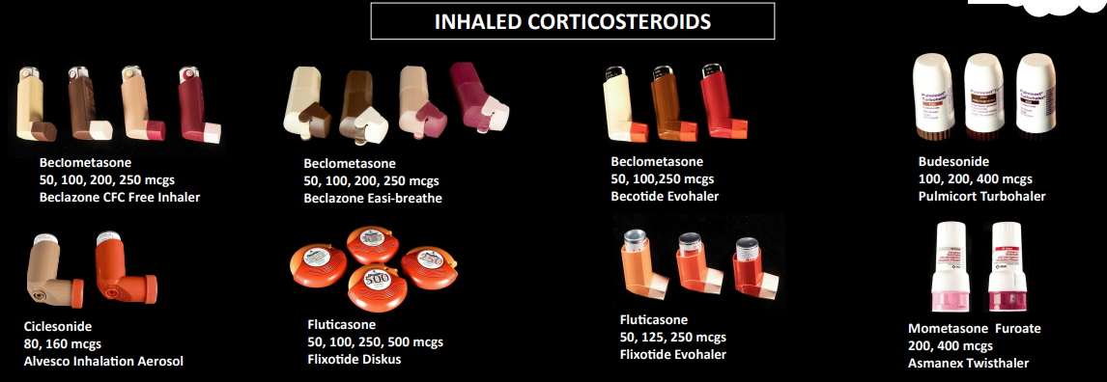
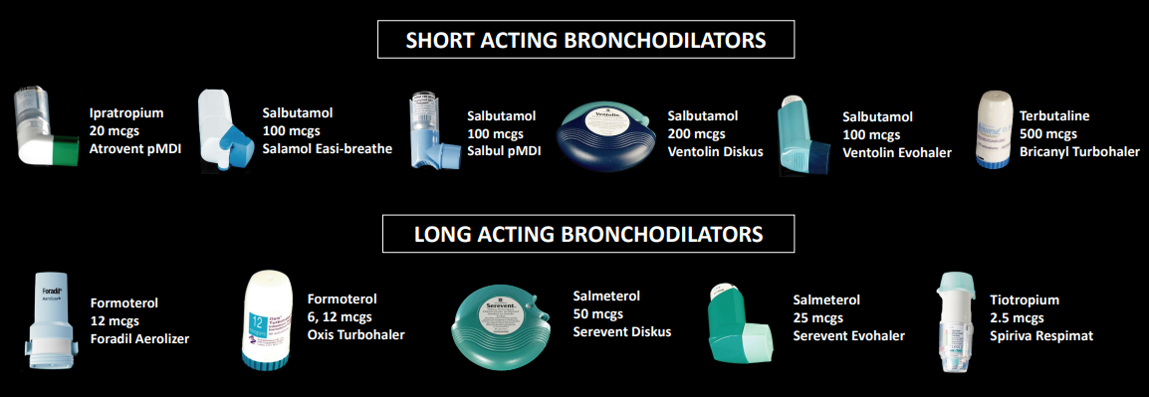
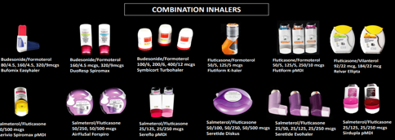
Types of Treatment
Preventers
Relievers
Notes:
Examples of the many different types of inhalers and what their role is in asthma management.

Slide 24
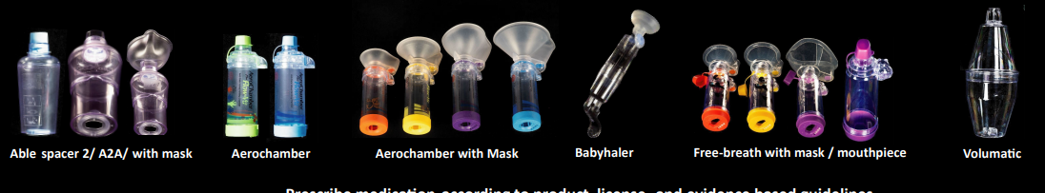
Spacer devices
Different types of spacers available for use with gas propelled inhalers .
https://www.beatasthma.co.uk/resources/families-children/asthma-medicines-information/
Notes:
It is important that the correct technique is done with the spacer .
All families and children should have training in the correct use of inhalers .
Link to videos on the correct inhaler technique for each different inhaler.

Slide 25
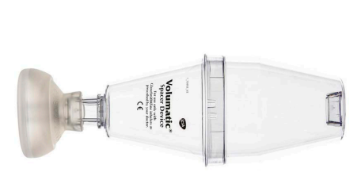
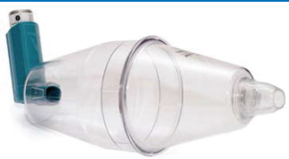
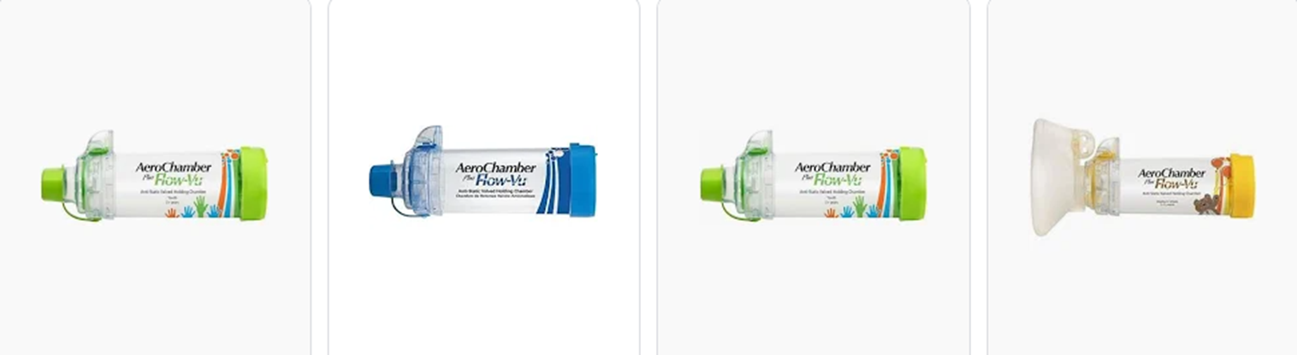

Slide 26
Challenges
Age
Ability to use
Denial /Recognition/perception
Negotiation
Mental health
Peer pressure
Concordance
Level of understanding
Knowledge of asthma

Slide 27
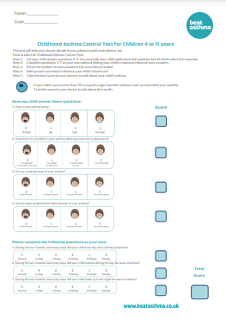
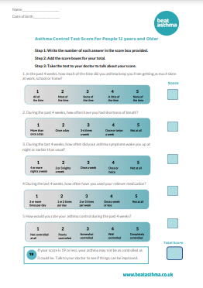
History and investigations
Frequency of SABA
Frequency of symptoms
Night disturbance
Exercise tolerance
Triggers/allergy
ACT score
Spirometry /PEFR
FENO
Reason for poor school
attendance
Notes:
Other factors involved in inhaler choice will be included such as onset and severity of symptoms.

Slide 28
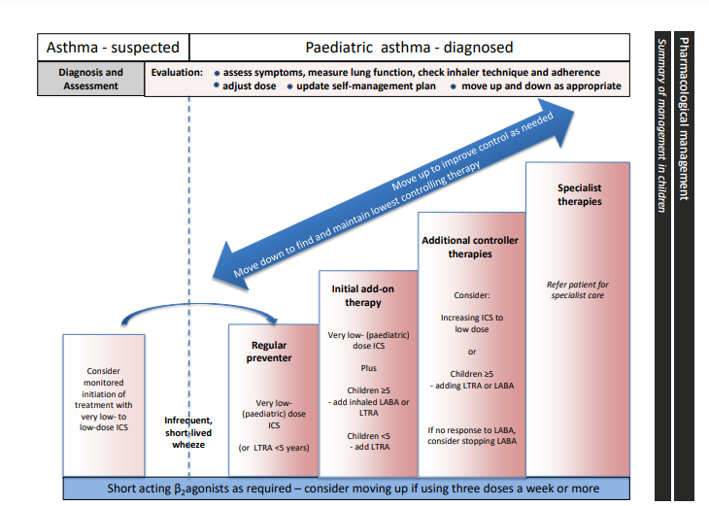
Treatment /inhaler/ options

Slide 29
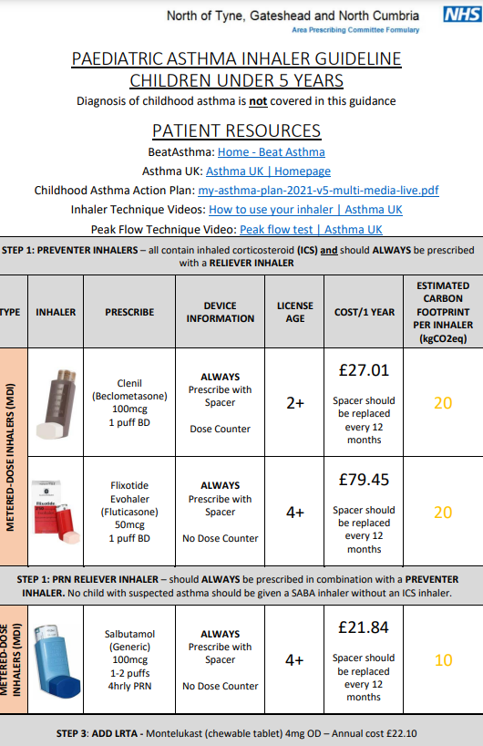
http://www.northoftynepc.nhs.uk/wp-content/uploads/sites/6/2023/01/Asthma-in-children-Full-Guideline-January-2023.pdf

Slide 30
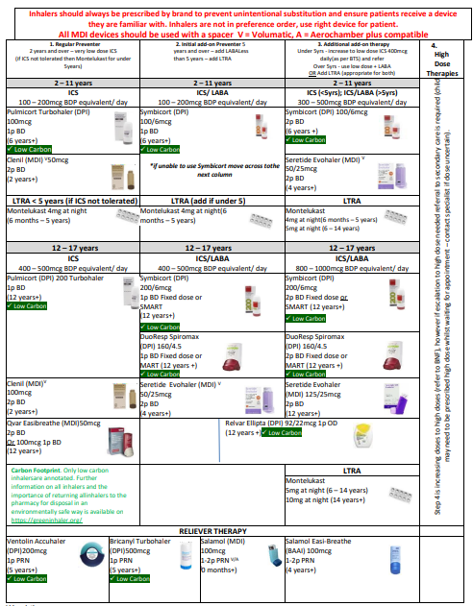
https://medicines.necsu.nhs.uk/guidelines/tees-guidelines/

Slide 31
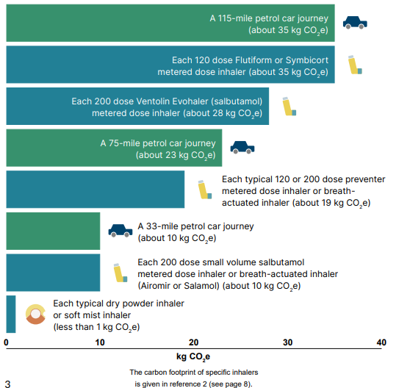

Slide 32
Inhaler Choices for CYP
Questions ?
Notes:
Excellent great to be able to share this information tonight, thanks very much Carol
Again an opportunity for discussion…….
For the third section of the Webinar tonight we will hear briefly from Dr Moss about overuse of SABA
Dr Moss is Consultant Respiratory Paediatrician at Great North Childrens Hospital and is the Clinical Lead for the NENC Asthma Programme, Dr Moss has worked in this field for over 15 years and has been involved with local and national projects to improve the care of young people
Thanks Sam

Slide 33
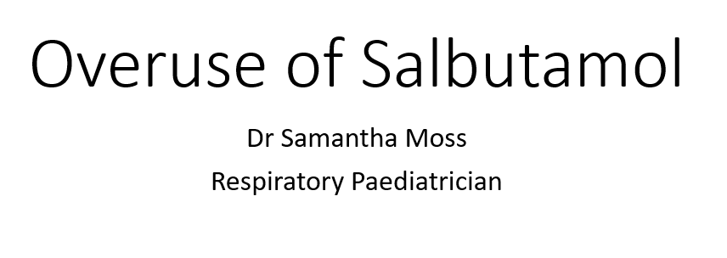

Slide 34
What is SABA overuse?
3 or more days a week using SABA for relief of symptoms (BTS/NICE)
NRAD – 56% patients >6 inhalers in previous year, 39% >12 SABAs
National bundle report no of patients with >3 SABAs a year

Slide 35
Overuse or Over Prescribing
How many SABA inhalers does a child need at diagnosis?
How often do these need to be replaced?
What happens to unused inhalers?

Slide 36
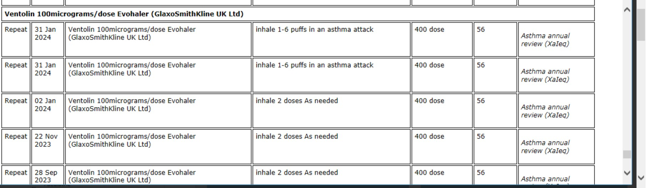

Slide 37
Additional Impact of Over Prescribing SABA
Every year in NENC over 200 000 salbutamol inhalers are prescribed at a cost of £400 000 to the NHS
Each inhaler has a carbon footprint of 28 kg, this is the equivalent of driving from the north-east to London & back 2,500 times
Family members using SABA…

Slide 38
How do we tackle overuse/overprescribing
A CHILD WITH ASTHMA SHOLD NEVER BE LEFT WITHOUT ACCESS TO SABA
Discussion with family and patient (if necessary increase background treatment)
Don’t accept SABA being routinely ticked on repeats, question if they are really needed
After initial diagnosis only prescribe 1 SABA at a time

Slide 39
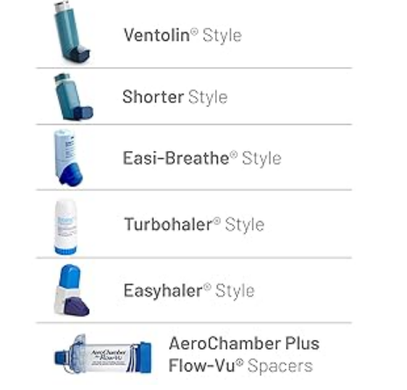
Over Use of Salbutamol Questions/Discussion
Notes:
Thank you Dr Moss
If I can open the floor for discussion and questions, I appreciate that some of the questions have been responded to in the chat function ……
Great then trying to keep to time so if we can move on to the final section, where we will hear from Dr Hegab about paediatric asthma referral pathways and available resources
Dr Hegab is Consultant Paediatrician with a special interest in respiratory medicine at James Cook hospital as well as being a clinical advisor to the CHWN. Dr Hegab has led the development of multi agency conference and looks forward to collaboratively working to improve Asthma Care for CYP in the North East and North Cumbria.
Thanks Dr Hegab

Slide 40
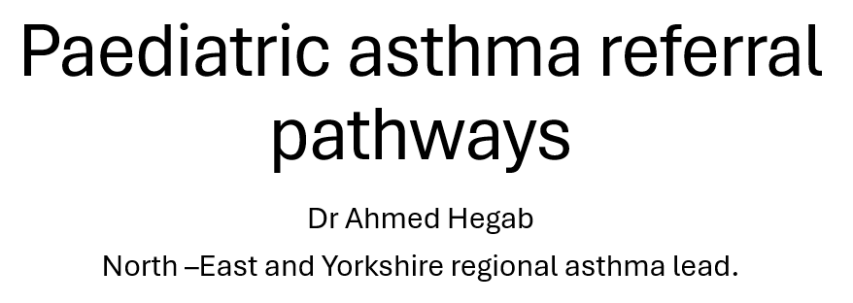

Slide 41
Referral to General Practice
Criteria for community pharmacy referral to GP Practice:
The use of over 6 SABA inhalers per year
If ≤ 75% of prescribed inhaled corticosteroids have been collected in the last year (or pro rata).
Issue of an emergency supply for a SABA to a CYP.
Please use referral letter on Healthier together website:Asthma Letter Templates for Schools and Club : North East and North Cumbria Healthier Together (nenc-healthiertogether.nhs.uk)

Slide 42
Referral to General Practice
Criteria for school or community organisation referral to GP Practice:
Asthma-related school absences
Asthma-related nonparticipation in physical activity
The need for unplanned use of a reliever inhaler more than twice a week in school indicates poor control requiring action.
Please use referral letter on Healthier together website:Asthma Letter Templates for Schools and Club : North East and North Cumbria Healthier Together (nenc-healthiertogether.nhs.uk)

Slide 43
Managing uncontrolled asthma
Assess current asthma control – using asthma control test
Assess and reduce modifiable risk factors:
Co-morbid atopic conditions (Hay fever, eczema, allergy, ….)
Obesity
Tobacco smoke exposure: Smoking cessation advice and sign posting to services
Review inhaler technique
if poor, either correct or issue a new device that the patient can use
Review concordance
Ask about medication use and look at the number of preventer inhalers that have been issued in the last year

Slide 44
Managing uncontrolled asthma
Identify and eliminate trigger factors (consider allergen exposure, environmental factors etc)
Optimise care according to national/local asthma guidelines:
https://www.beatasthma.co.uk/resources/primary-healthcare-professionals/
A health review to consider other conditions impacting asthma and management (diet, weight, lifestyle) and signposting for further support
Discussion with the parent or carer about housing (Beat Asthma resources):
https://www.beatasthma.co.uk/wp-content/uploads/2017/10/1-Your-Home-and-your-Child%E2%80%99s-Health-2.pdf

Slide 45
Other factors to consider
Other medical / long term conditions
Mental health and psychological factors
Social deprivation, family circumstances and support
Looked after children and young people
Nutrition
School environment

Slide 46
Referral criteria from primary care to secondary care
≥2 courses oral corticosteroids per year, despite addressing all points highlighted uncontrolled asthma section and appropriate escalation as per BTS/GINA guidelines.
persistent chronic symptoms (most days for >3 months) or worsening of symptoms
>1 hospital admission or ED attendance per year
The use of >6 SABA inhalers per year.
Asthma Control Test (ACT) / Childhood Asthma Control Test (c – ACT) score of <20 despite trial of appropriate management strategies in primary care following BTS/GINA guidelines (Poor asthma control despite GINA step 2).
Diagnostic uncertainty.
Persistent psychosocial concerns despite appropriate support.
Persistent uncontrolled asthma with safeguarding concerns after referral to social services following local safeguarding pathway.

Slide 47
Healthier Together
https://www.nenc-healthiertogether.nhs.uk/professionals/asthma/asthma-referrals-pathway.
Referral form and check list: easy to use

Slide 48
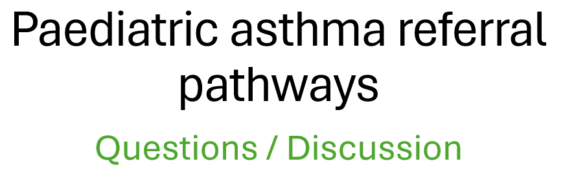
Notes:
Excellent – great presentation. Slides and resources from the session tonight will be shared so colleagues can access the links from Dr Hegab’s presentation as well as all the others
If we can spend a few minutes now with any discussion items from the group

Slide 49
Thank you !!
Please follow, share and retweet relevant work so that we can continue to share good practice across the region at the Child Health and Wellbeing Network handle @EveryChildNENC Visit our website - Child Health and Wellbeing Network | North East and North Cumbria NHS (northeastnorthcumbria.nhs.uk) Please encourage colleagues from all areas of Child Health and Wellbeing to register via forms.gle/gG11zhr2Z8VLU2db9 so they are included in our communications and feed into the workplan projects that they are interested in.
Notes:
So to round up, wanted to extend a huge Thank you to all participants for your interest in this work and for joining us tonight, also an opportunity to say Thank you to all our presenters and members of the ALG.
Colleagues will monitor and respond to the chat for the next 24 hours and we will collate questions and responses and share these with those who have registered following the event.
The last slide here just provides some links to the CHWN webpage and also the link to sign up to our ever increasing membership if you aren’t already.
Many Thanks all

